Slide 1
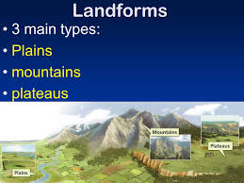
MAJOR LANDFORMS OF THE EARTH

Slide 2
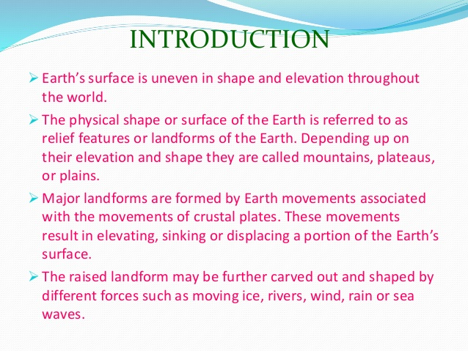

Slide 3
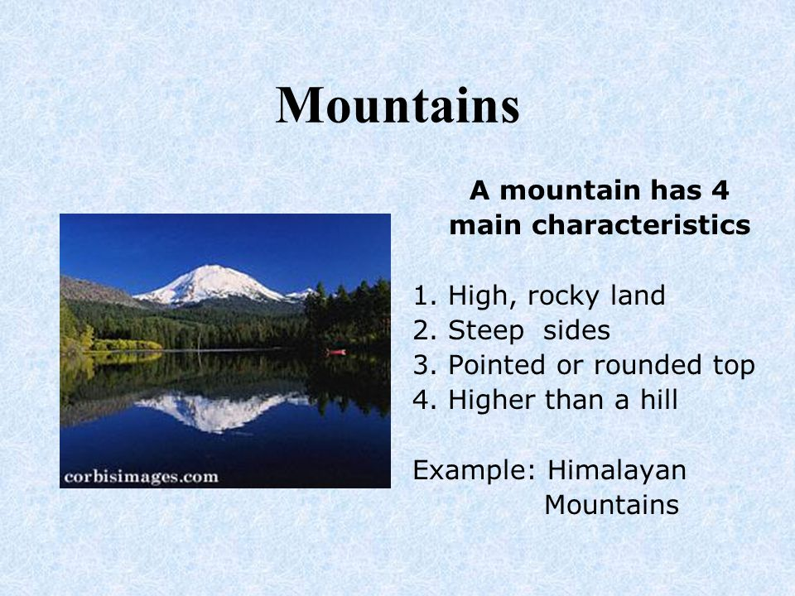

Slide 4
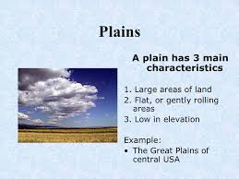

Slide 5
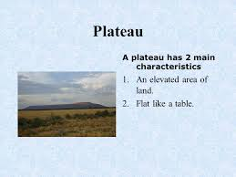

Slide 6
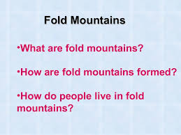
Words related to mountains
GLACIERS, RANGE, FOLD MOUNTAINS, BLOCK MOUNTAINS, VOLCANIC MOUNTAINS, HORSTS, GRABEN, RIVER VALLEYS, TERRACES, FLORA, FAUNA

Slide 7
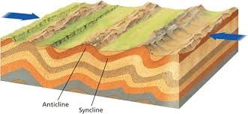

Slide 8
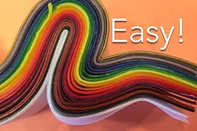

Slide 9
WORK TO BE DONE
HOME WORK
COLLECT PICTURES OF FOLD MOUNTAINS AND PASTE.
ALSO OF GLACIERS, RIVER VALLEYS AND PASTE.
( WRITE A LINE OR TWO ON THE TERMS RELATED TO MOUNTAINS)

Slide 10
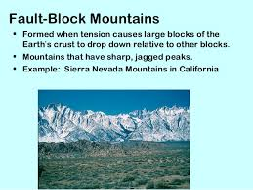

Slide 11
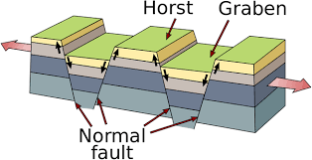

Slide 12
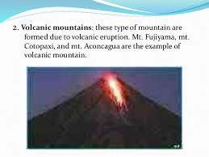

Slide 13
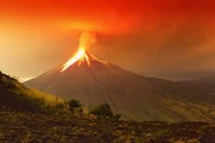

Slide 14
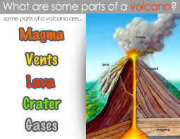

Slide 15
WORK TO BE DONE
DRAW A VOLCANIC MOUNTAIN AND LABEL ITS PARTS.
DEFINE THE PARTS OF A VOLCANO IN A LINE.

Slide 16
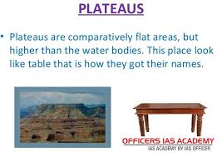

Slide 17
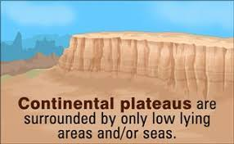

Slide 18
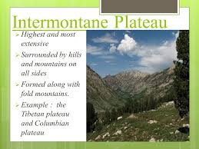

Slide 19
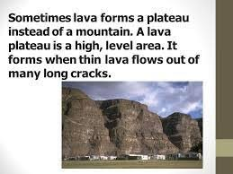

Slide 20
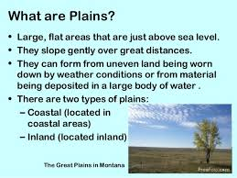

Slide 21
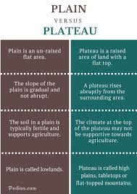

Slide 22
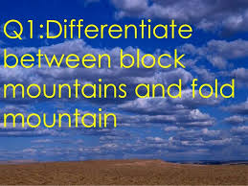

Slide 23
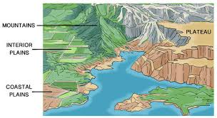
OUT OF THESE THREE, WHICH IS LEAST POLLUED AND WHY?

Slide 24
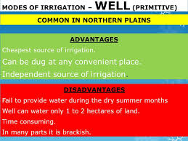

Slide 25
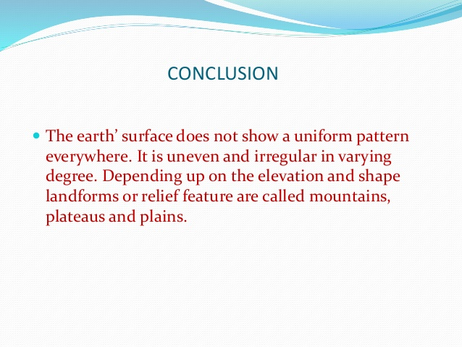

Slide 26
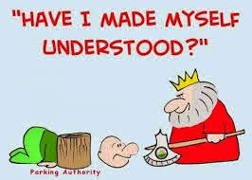

Slide 27


